Slide 1

COMP 490/L: Senior Design Project
Fall 2022
EarWorm
490/L Project Presentation
Supervisor:
Professor Ed Dantes
Team Members:
Alvaro Lopez-Romero (Team Leader)
Mitchell Mercer
Nathalie Claire Tivar
Rodolfo Rivera
Charles Quebral
Notes:
Alvaro

Slide 2
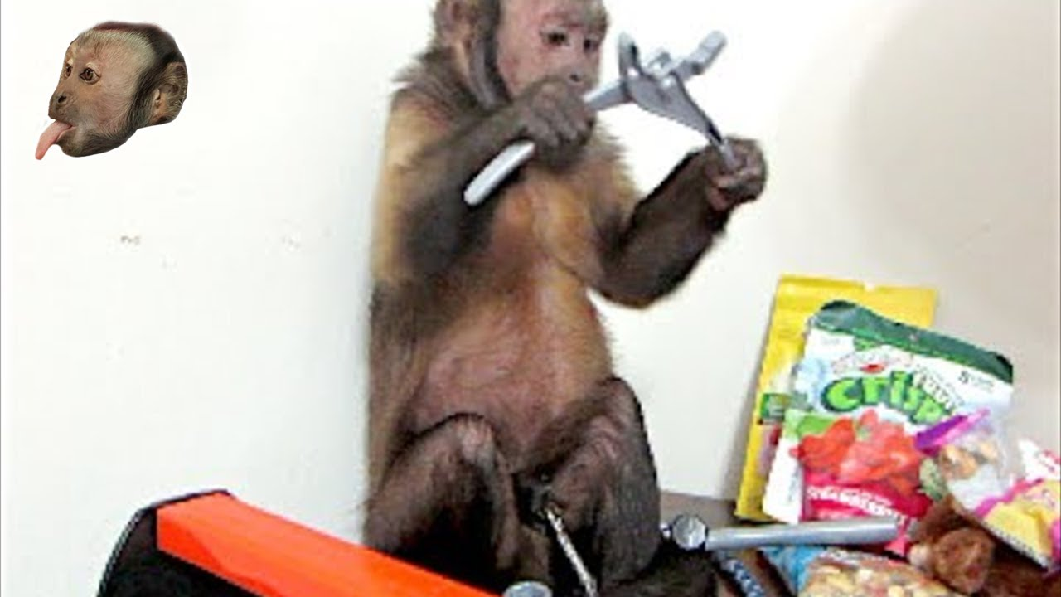
AGENDA
What is Earworm?
What technologies we are utilizing?
Why are we using them?
Did we have to adjust our approach?
Future enhancements and implementations?
Notes:
Alvaro

Slide 3

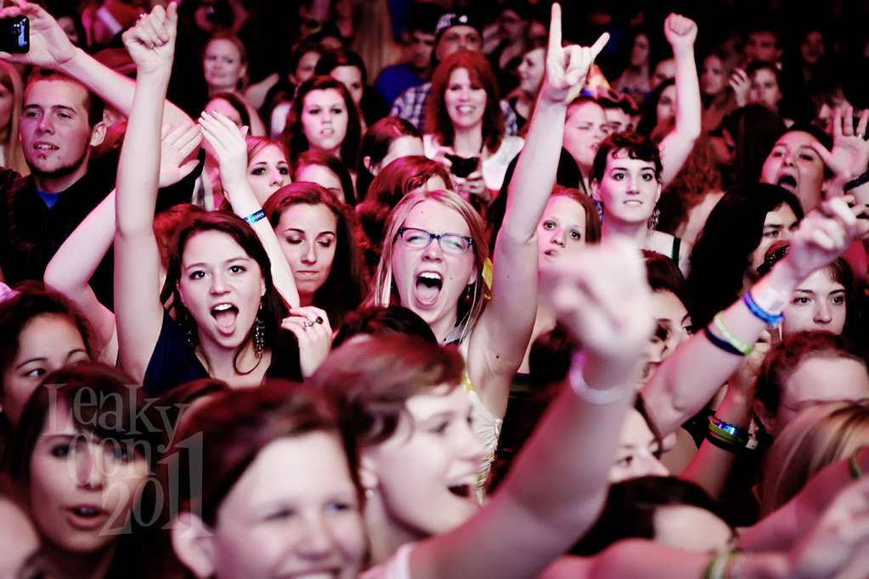
PROJECT OVERVIEW
Match People together
Like Tinder
Not Necessarily romantic
Achieved (eventually) by matching people together using Machine Learning
Notes:
Nathalie

Slide 4


PROBLEM DEFINITION
Need to make a website
Need to track individual users
Need to Determine Music Taste
Finally Match them based on that assigned music taste as well as data points like age, sex, location and etc.
Notes:
Charles

Slide 5
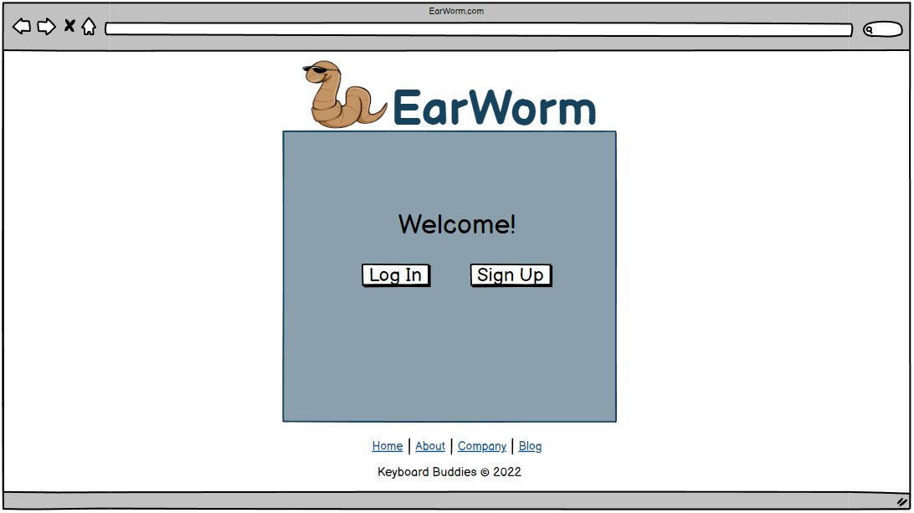
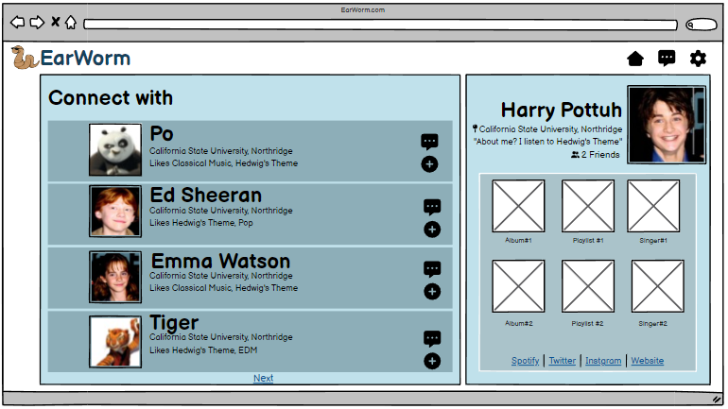
APPLICATION SCREENSHOTS
Notes:
Nathalie

Slide 6
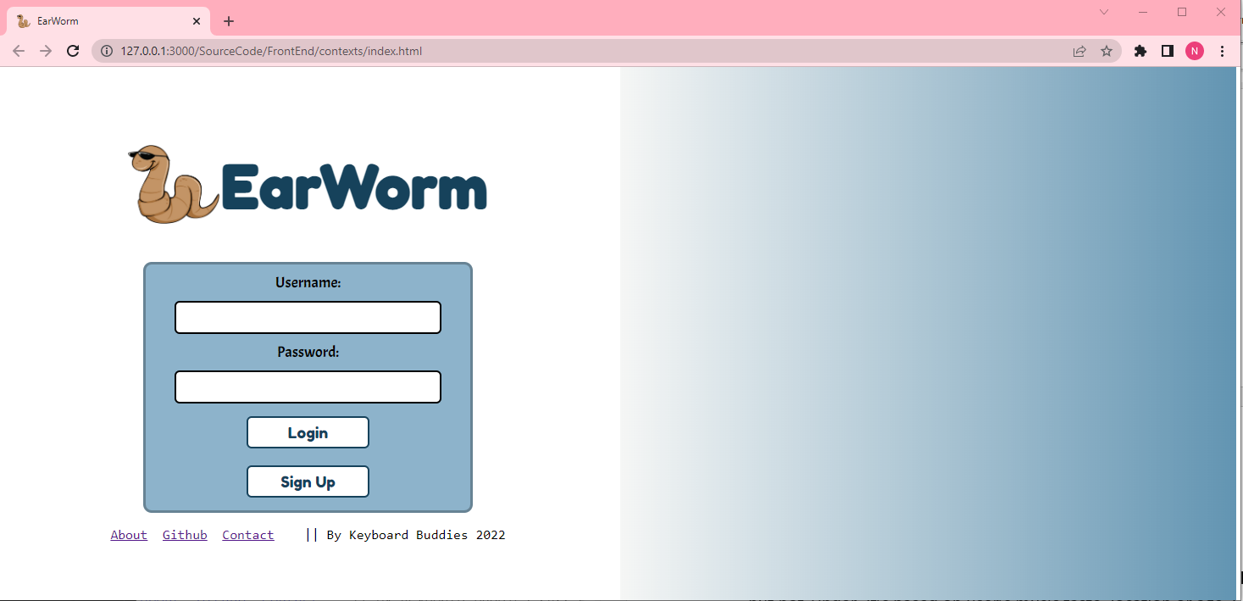
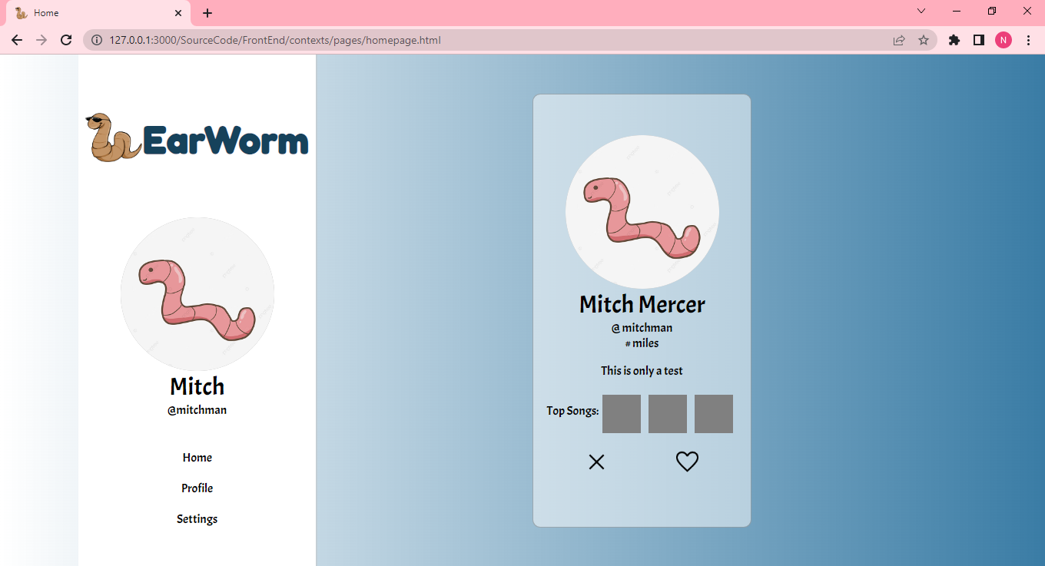
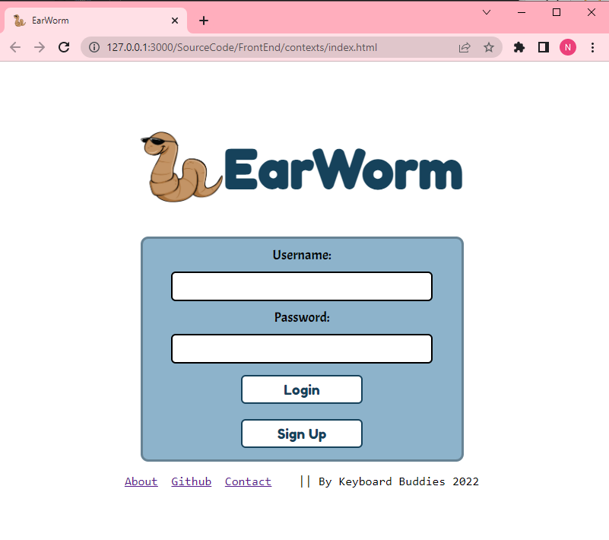
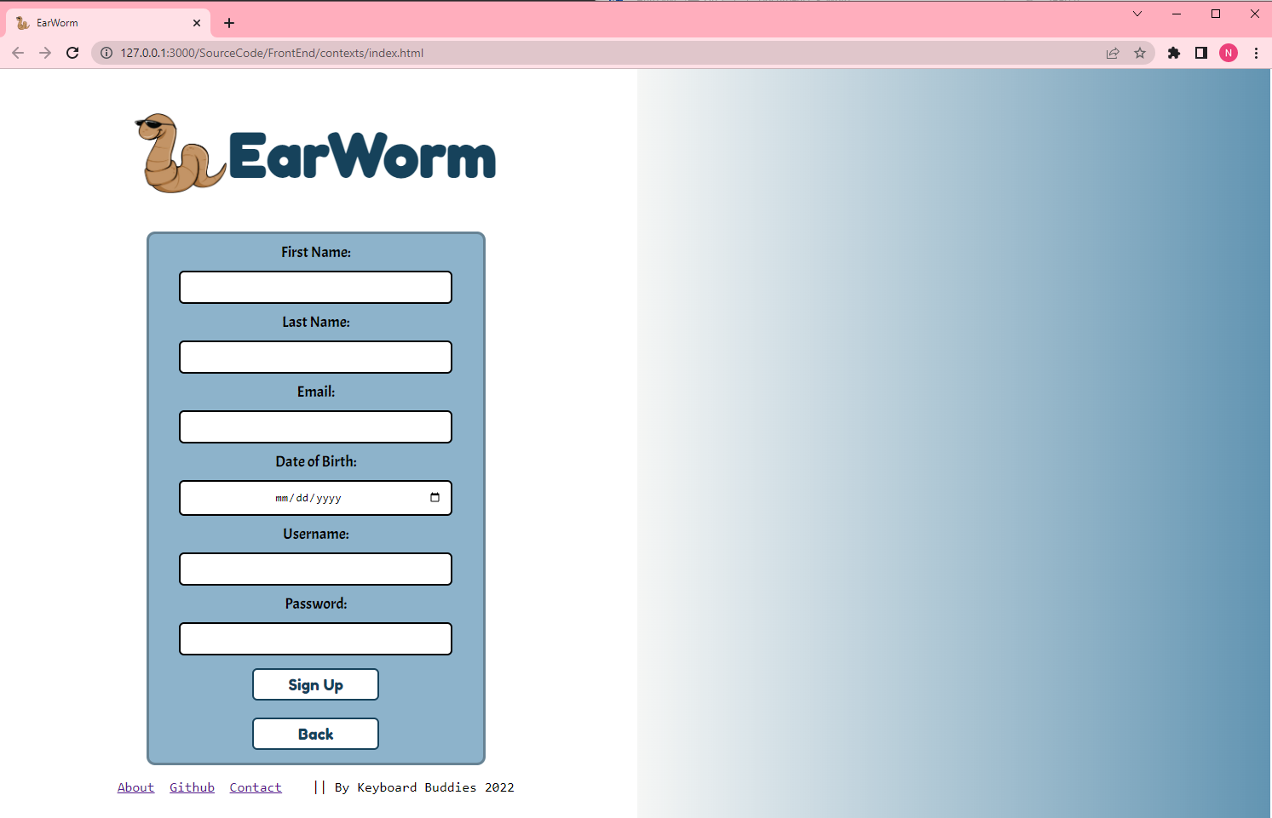
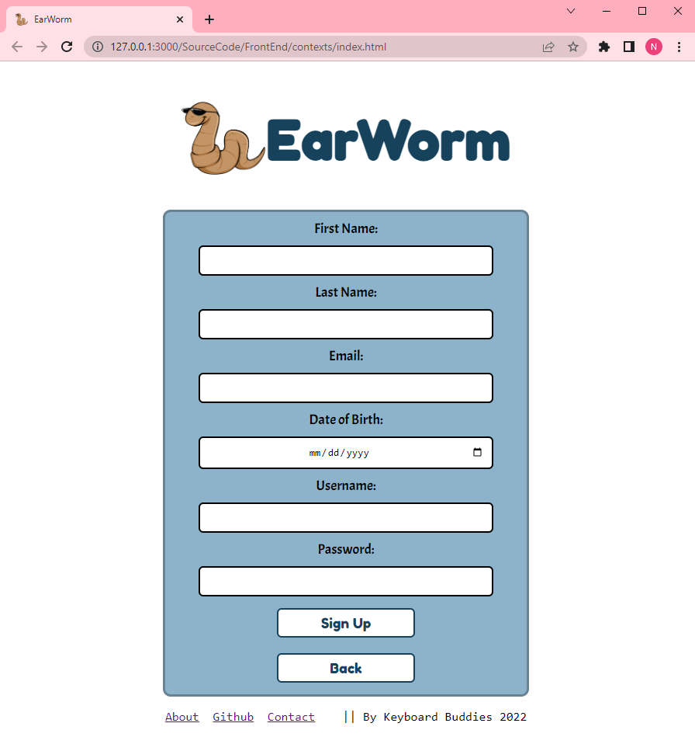
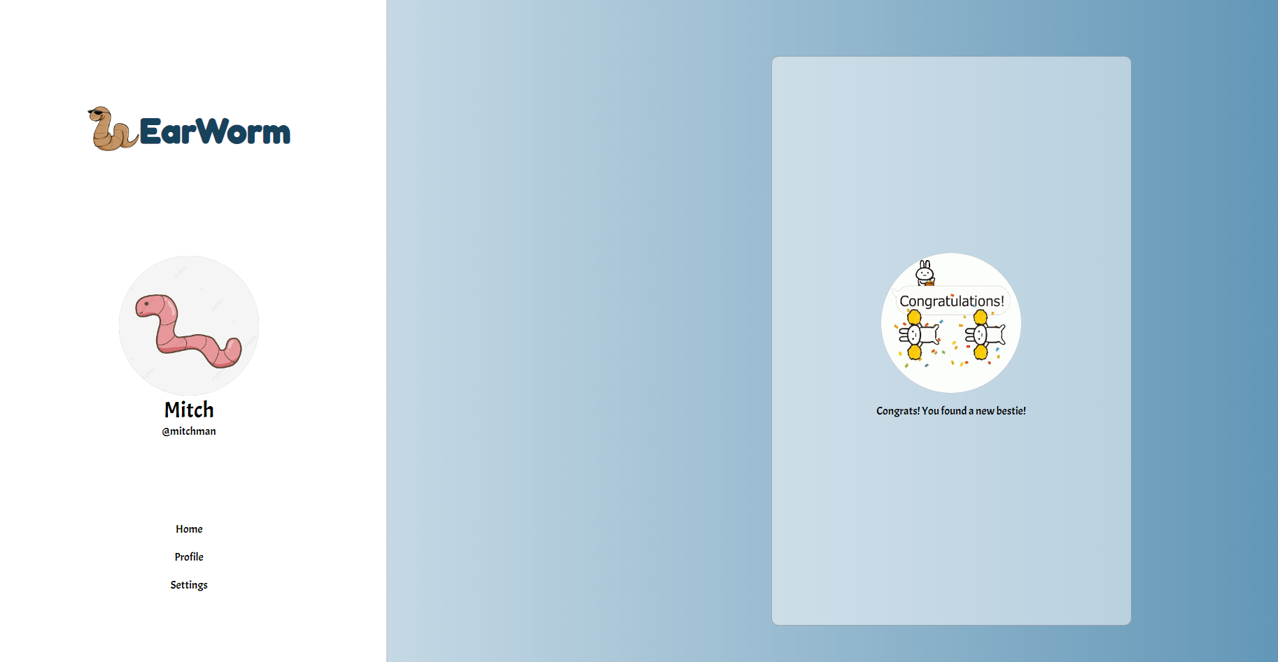
APPLICATION SCREENSHOTS
Notes:
Nathalie

Slide 7

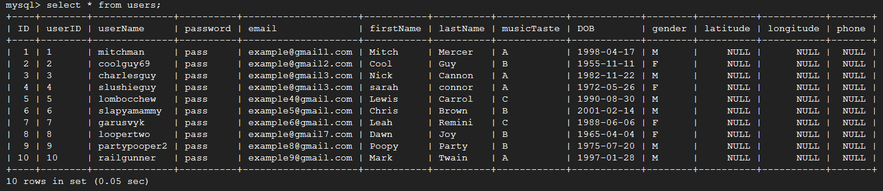
Utilizing Google Cloud will be running a MySQL 8.0 Database instance.
All Relevant Data points will be stored into this DB via the backend.
Facilitated by Spring-Boot application framework.
Notes:
Mitchell

Slide 8
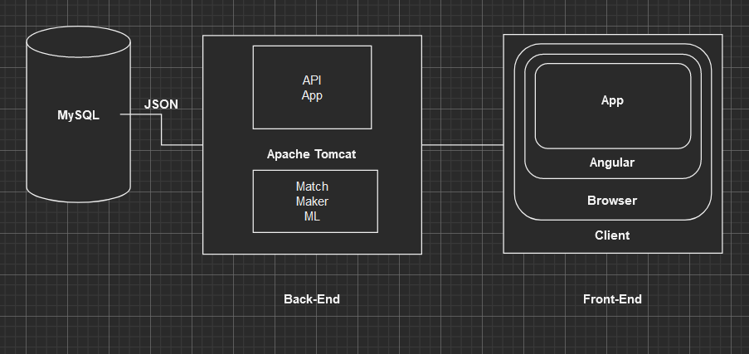
SOFTWARE OVERVIEW
Notes:
Mitchell

Slide 9
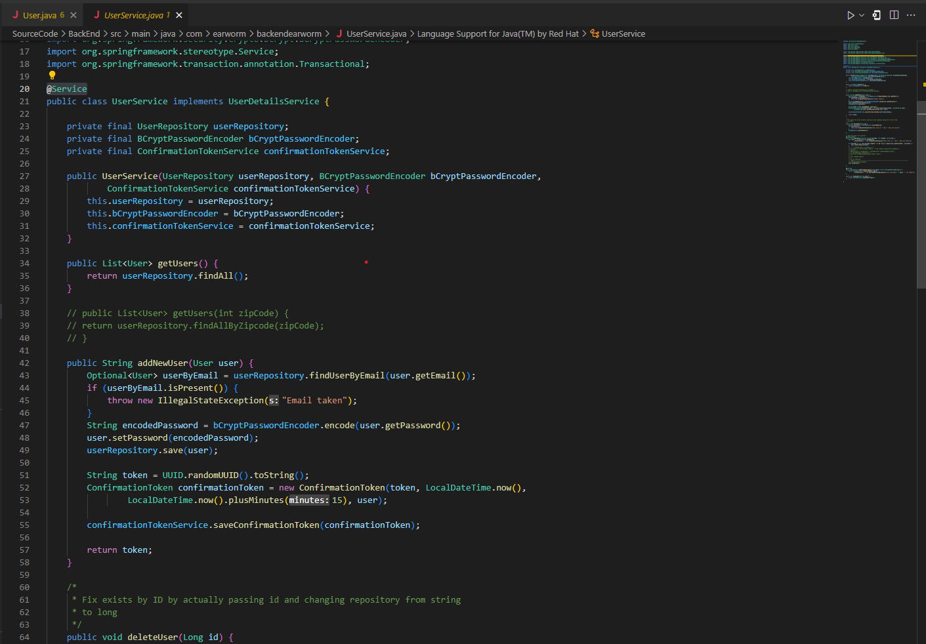
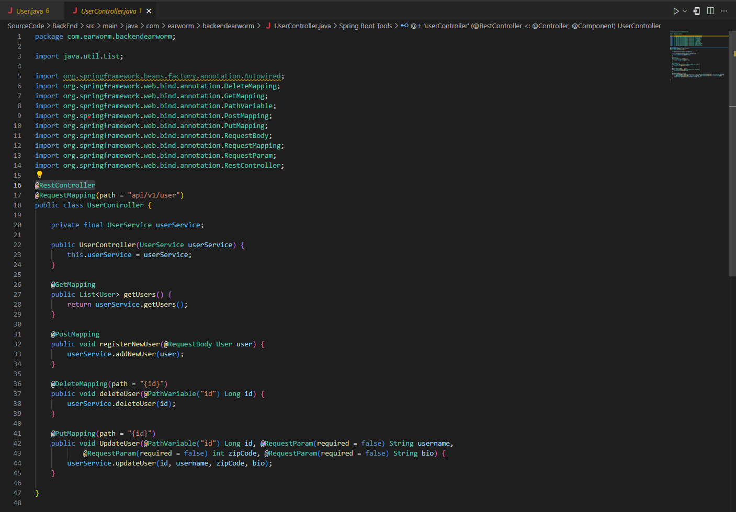
SAMPLE CODE SNIPPETS
Notes:
Rodolfo

Slide 10
APPLICATION
DEMO
Notes:
Rodolfo

Slide 11
PROGRESS AND FUTURE WORK
Progress
Landing page, Home page, and Settings page
Display users from local .csv file
Runs on browser
Future Work
Google Cloud + MySQL
Spotify Credentials
Machine Learning to display accounts
Display preferences (theme, distance, music taste, age, sex, etc)
Notes:
Charles

Slide 12
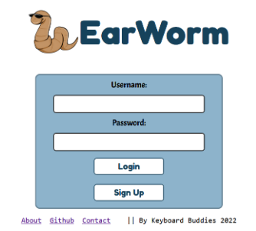
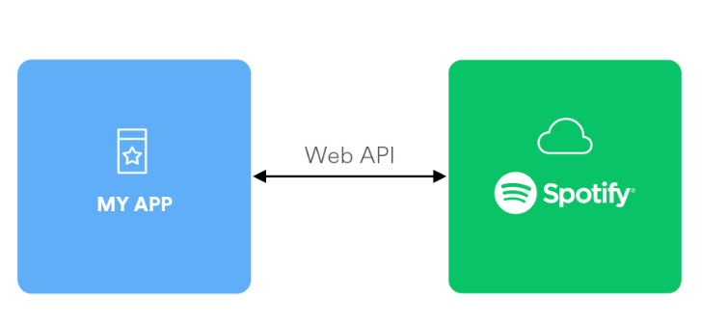
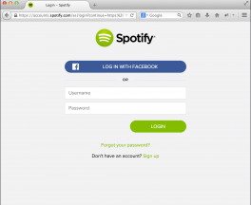
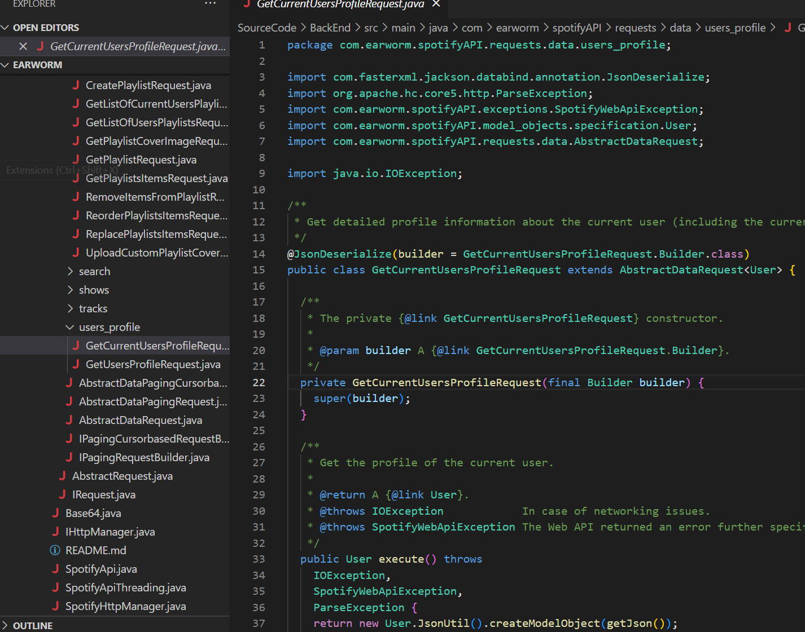
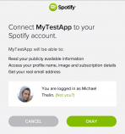
EarWorm and Spotify Web API Integration
Notes:
Alvaro

Slide 13

QUESTIONS?
JK JK
Notes:
Team

